Slide 1

CSE- 321
Software Engineering
Lecture : 01 Introduction
Fahad Ahmed
Lecturer, Dept. of CSE
E-mail: fahadahmed@uap-bd.edu

Slide 2
Lecture Outlines
What is Software?
Attributes of Good Software
Classification of Software

Slide 3
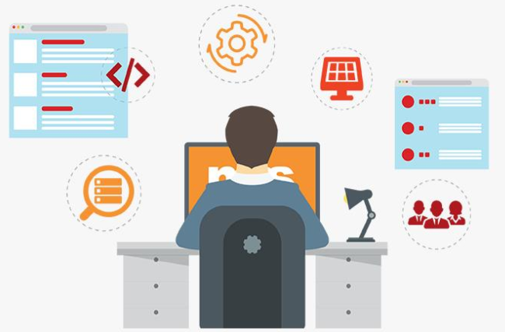
Are you a software Engineer ?

Slide 4
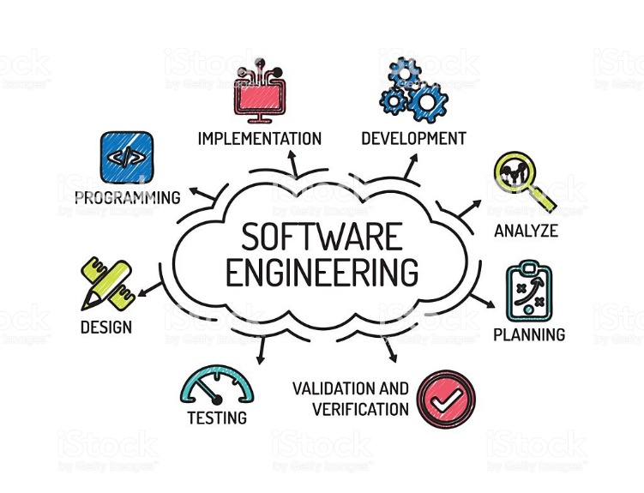
Software Engineering

Slide 5


Software Engineering
Software
Engineering
+
Product
Rules, Process, Manner

Slide 6
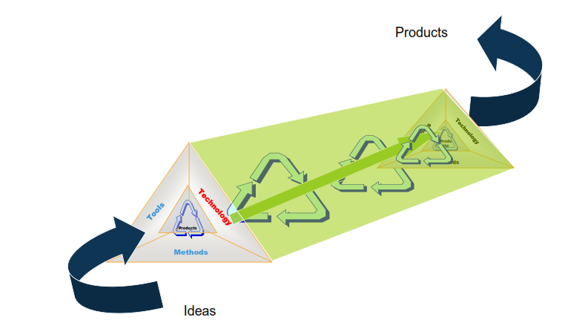
Software :: Product

Slide 7
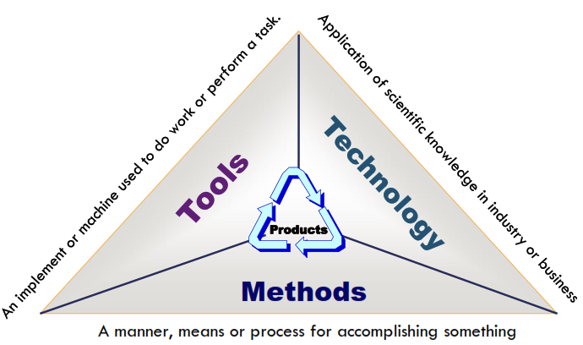
Software :: Product

Slide 8

Software
What is software?

Slide 9
Software
What does Software mean?
A set of instructions
A program is an executable code
Executable computer programs and associated documentation
A program or set of programs containing instructions which provide desired functionality .

Slide 10

Software
What does Software mean?
The Institute of Electrical and Electronic Engineers (IEEE) defines software as a
Collection of computer programs, procedures, rules and associated documentation and data.

Slide 11
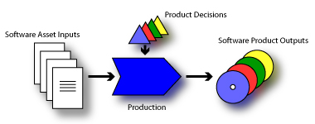
Software
What is software product?
Software, when made for a specific requirement is called software product.
Software products may be
Generic- developed to be sold to a range of different customers.
Customised (Bespoke) - developed for a single customer according to their specification.

Slide 12
Attributes of good software
Essential attributes of good software
Maintainability
Dependability and security
Efficiency
Acceptability
In addition to the above mentioned characteristics, robustness and integrity are also important.

Slide 13
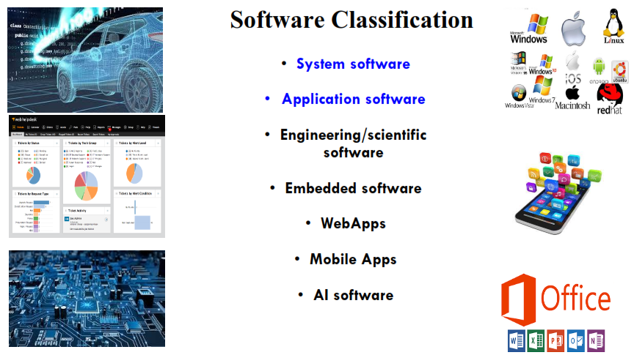
Classification of Software

Slide 14

Thanks to All

